Slide 1
Eco-Evolutionary Optimality (EEO) Models

Slide 2
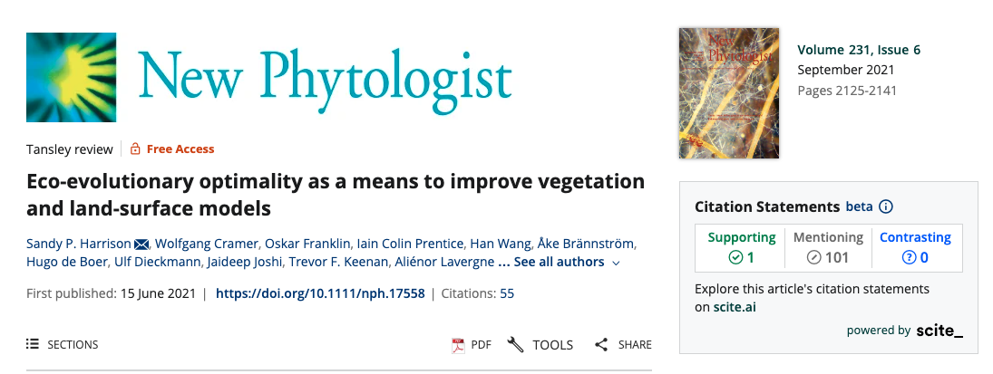

Slide 3
EEO invokes the power of natural selection to eliminate uncompetitive trait combinations, and thereby shape predictable, general patterns in vegetation structure and competition.

Slide 4
Where’d the name EEO come from?
Eco: trait adjustments can happen through ecophysiological responses on short time scales
Evo: trait adjustments can occur over evolutionary time scales

Slide 5
Some EEO examples

Slide 6
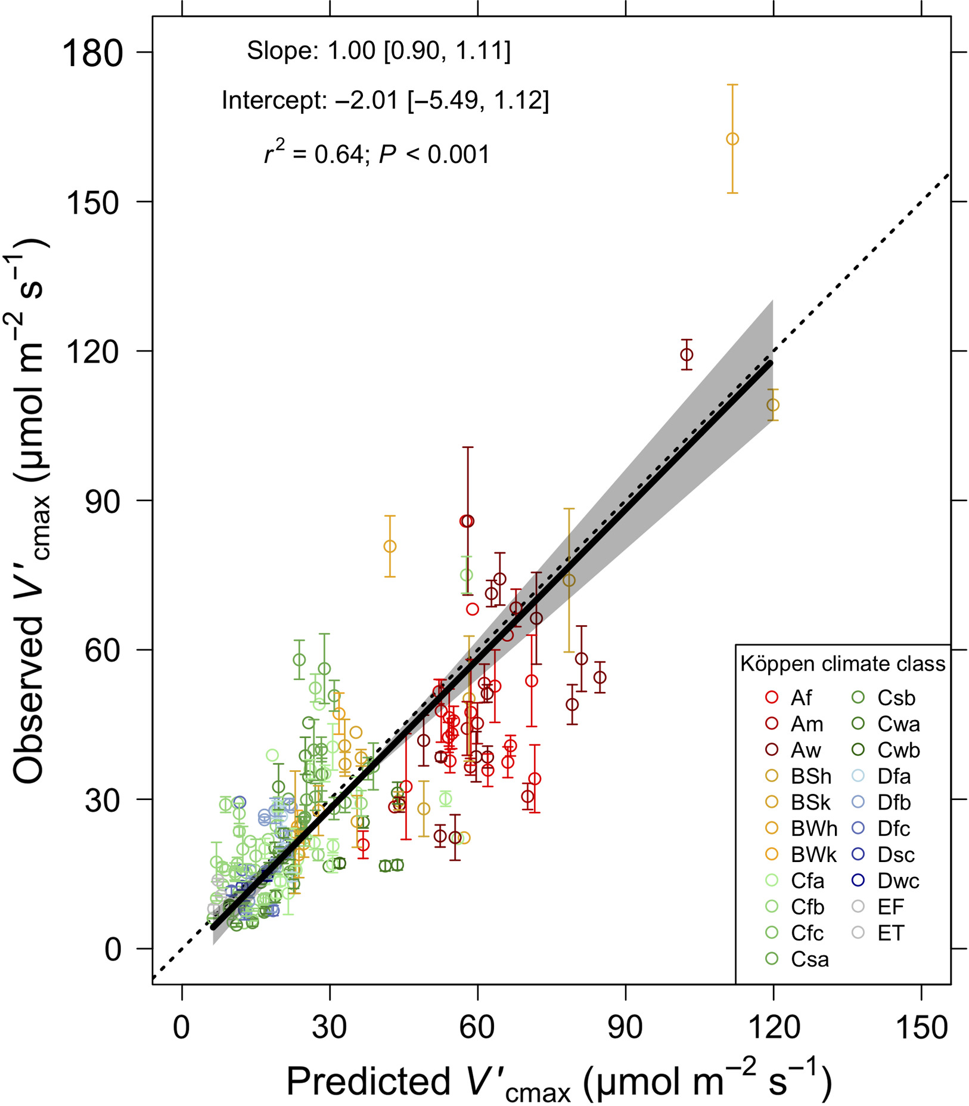
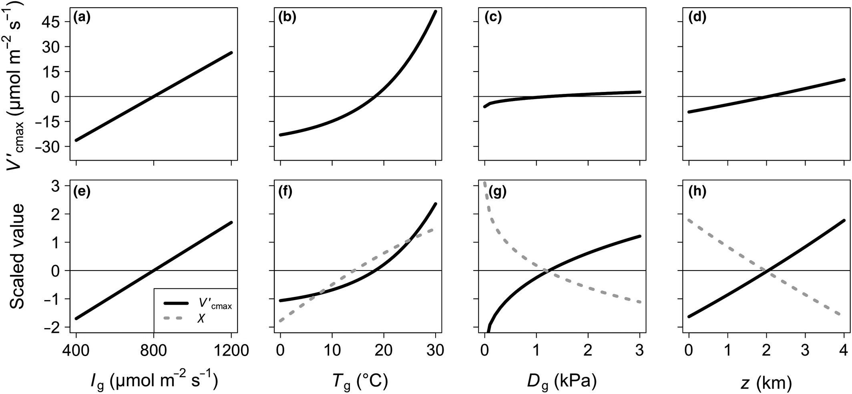
Photosynthetic capacity
Smith et al. (2019)

Slide 7
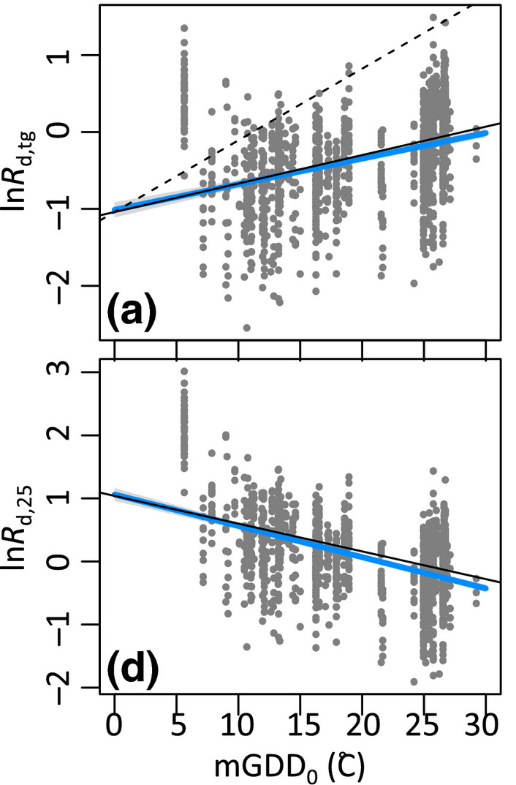
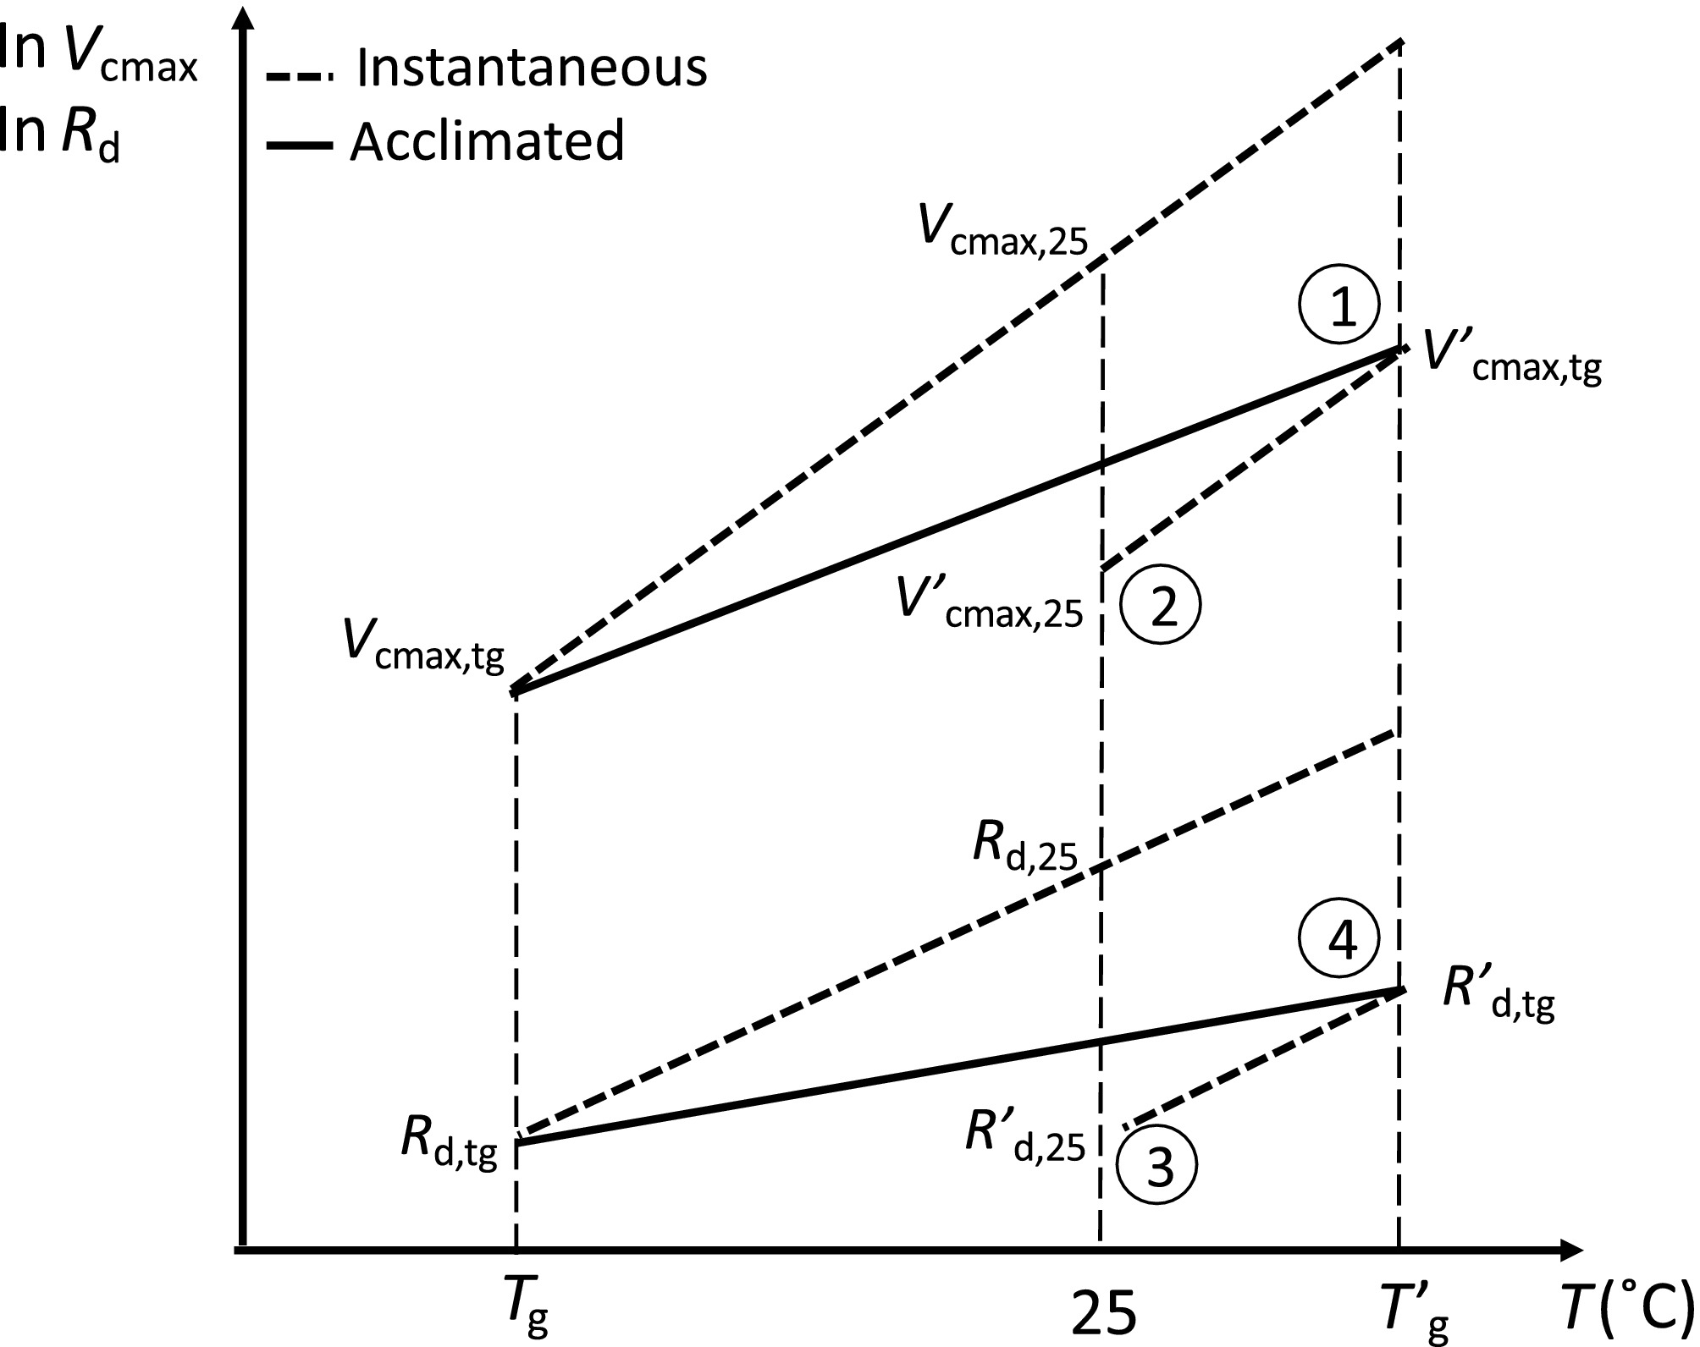
Dark respiration
Wang et al. (2020)

Slide 8
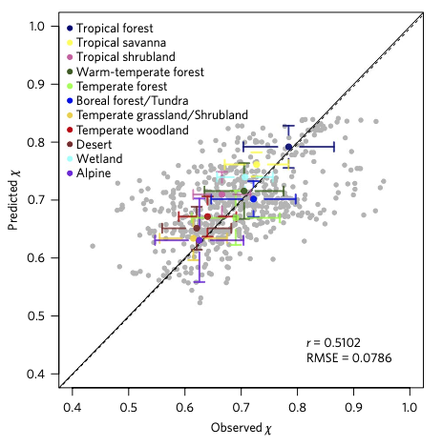
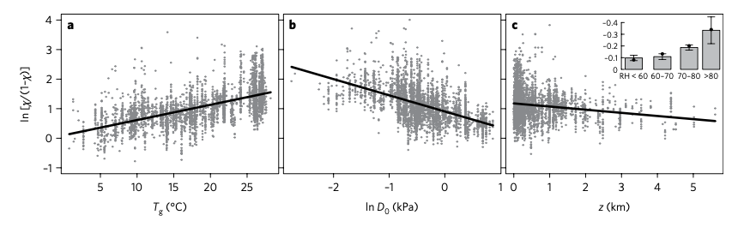
Stomata
Wang et al. (2017)

Slide 9
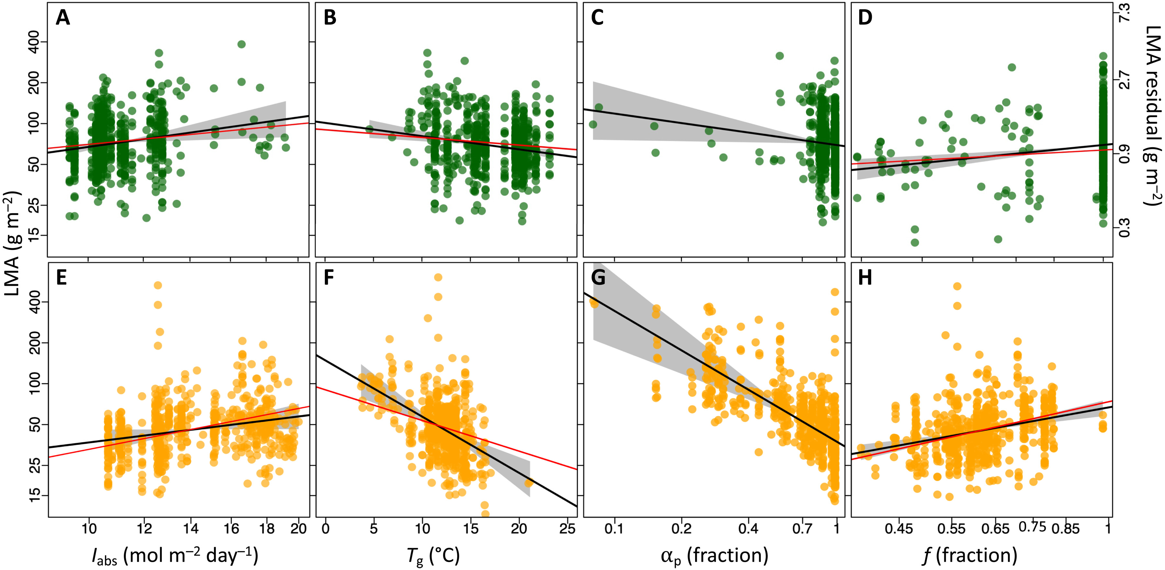
LMA
Wang et al. (2023)

Slide 10
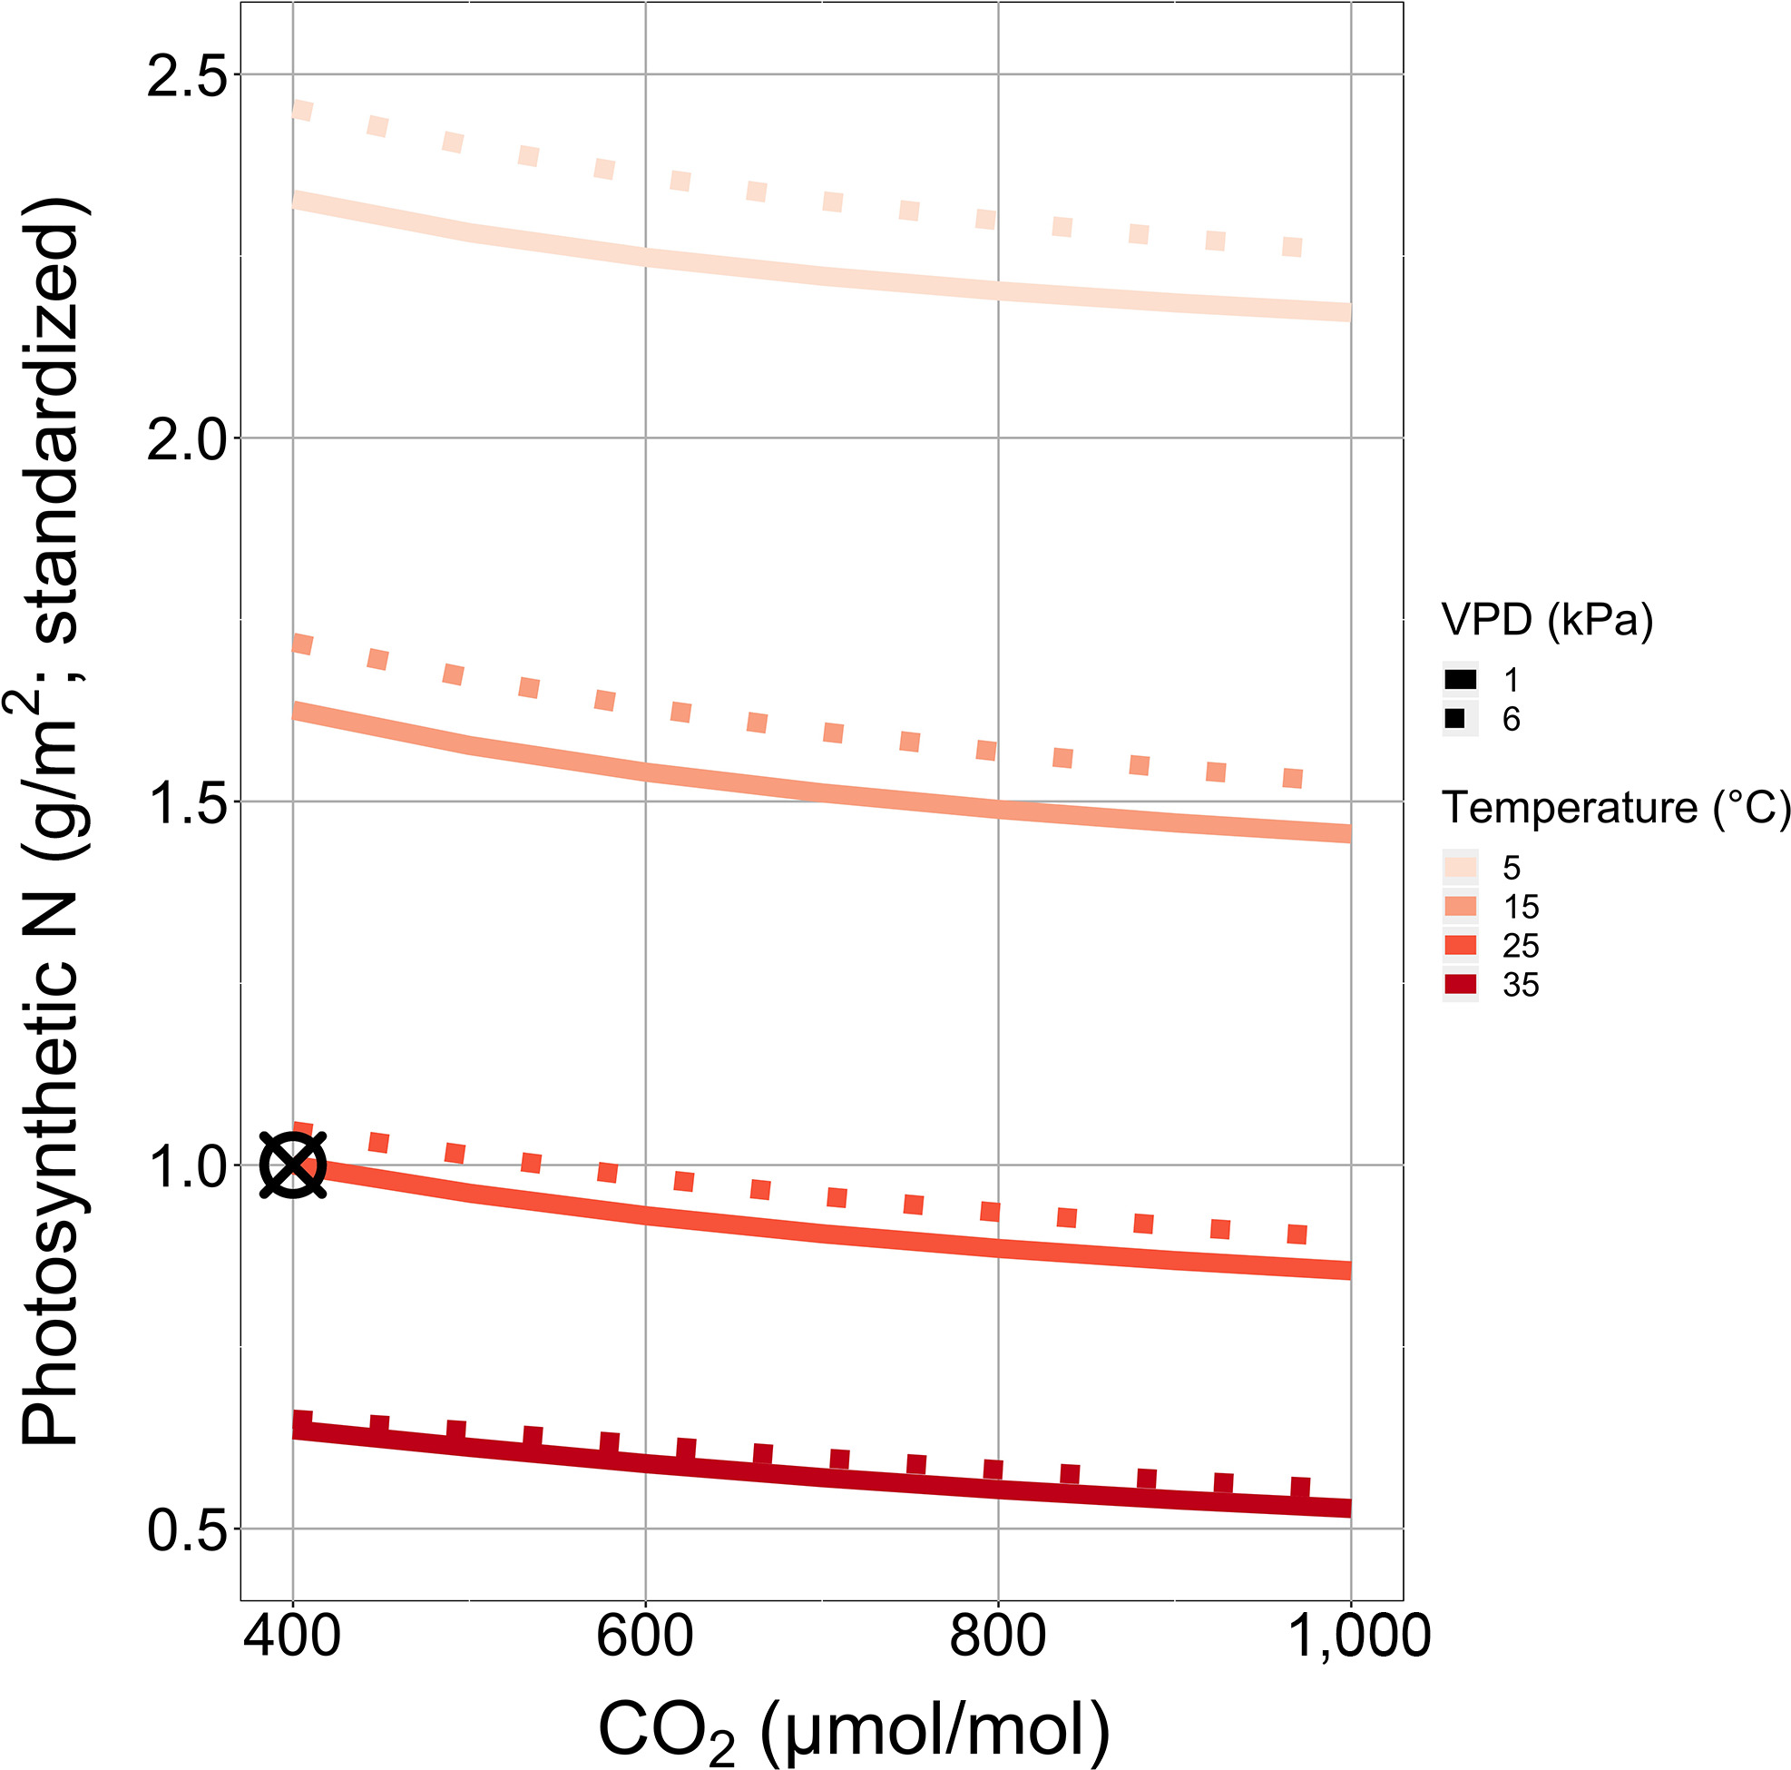
Leaf N
Smith and Keenan (2020)

Slide 11
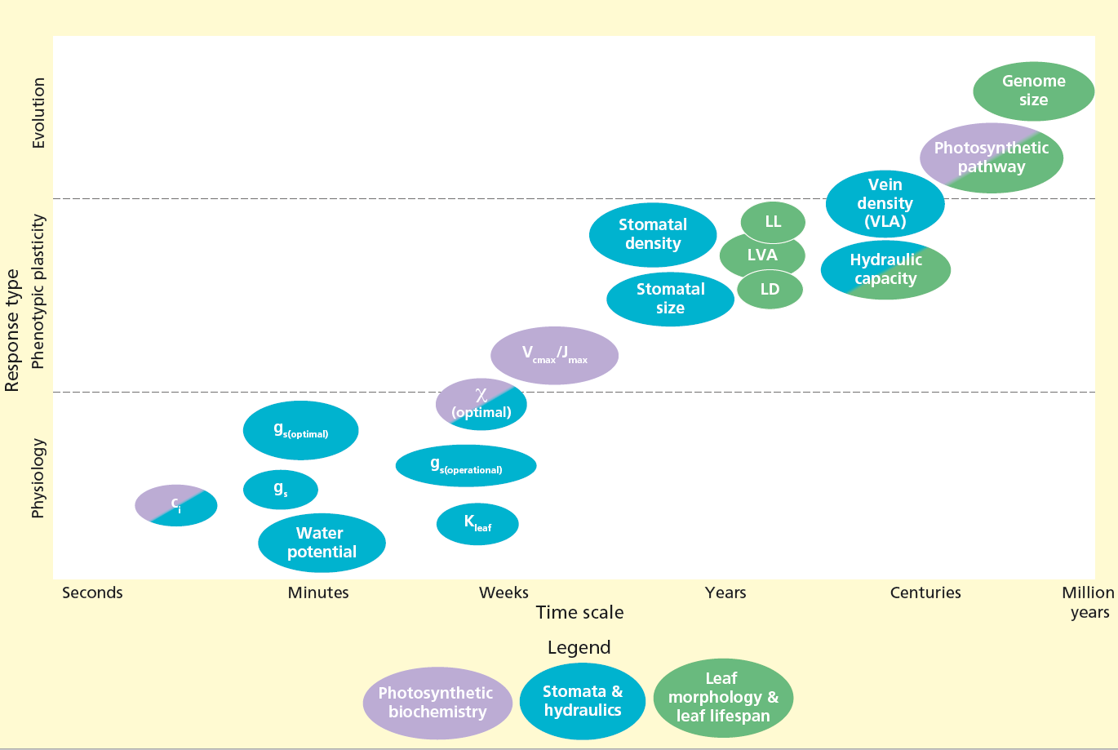
Timescale sidebar: there could be many!
Ode et al. (in review)

Slide 12
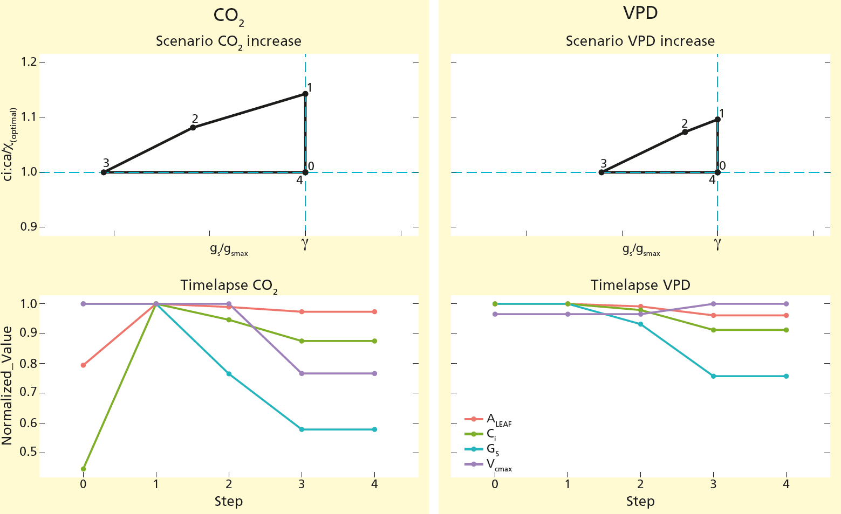
Ode et al. (in review)

Slide 13
EEO hypothesis development is based on trade-offs. Does your module process represent a trade-off?

Slide 14
Model development problems and solutions
Problem: models do not encapsulate a coherent body of theory
Solution: integrate testable theories and test one-by-one

Slide 15
Model development problems and solutions
Problem: lack of clarity about hypotheses
Solution: test processes independently

Slide 16
Model development problems and solutions
Problem: core process representations tend to be conserved
Solution: revisit and reevaluate core processes

Slide 17
Model development problems and solutions
Problem: neglect of available observations
Solution: use observations to test core assumptions (experiments are critical!)

Slide 18
Does your module represent a testable theory?

Slide 19
Moving beyond the leaf
Carbon allocation
Allocation to limiting pool
Soil-plant interactions and mycorrhizae
Additional allocation constraints
Competition and coexistence
Game theory

Slide 20
Outstanding issues
Natural selection acts on reproductive fitness
Limits on optimality are unknown
Optimality is approached by different processes
Dispersal/migration and absent species
Experiments are important
Fire and land use are difficult to deal with

